Slide 1
Adsorbing Hemoglobin in Column Flow Experiments – diff Eq analysis

Slide 2
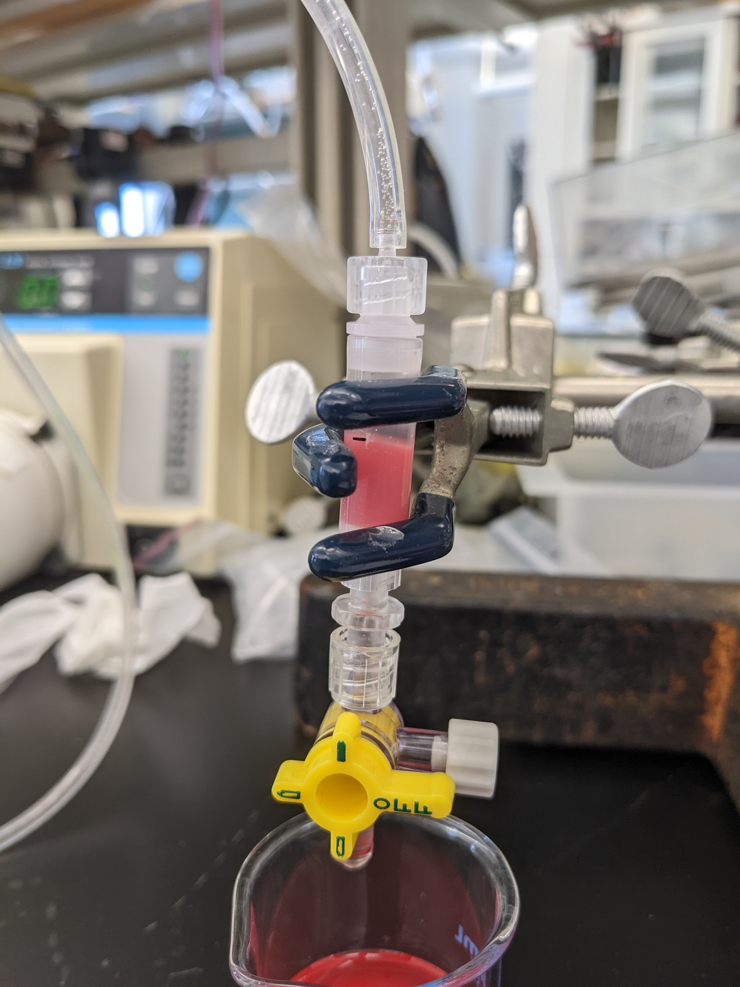
Background – Ex-vivo experiments
Columns are set up in PBS, tube primed with whole rat blood
Flow starts, outflow collected as sample per minute
Plasma hemoglobin concentration measured for haptoglobin-immobilized beads and control

Slide 3
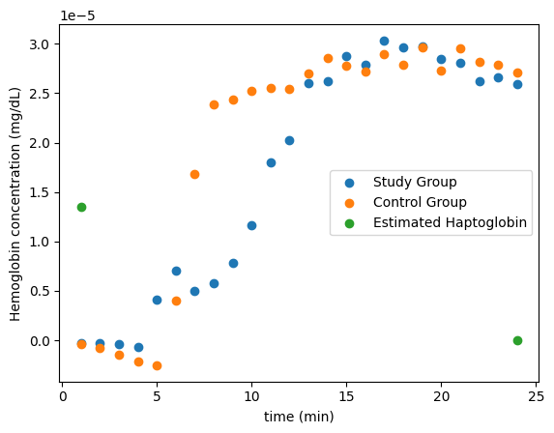
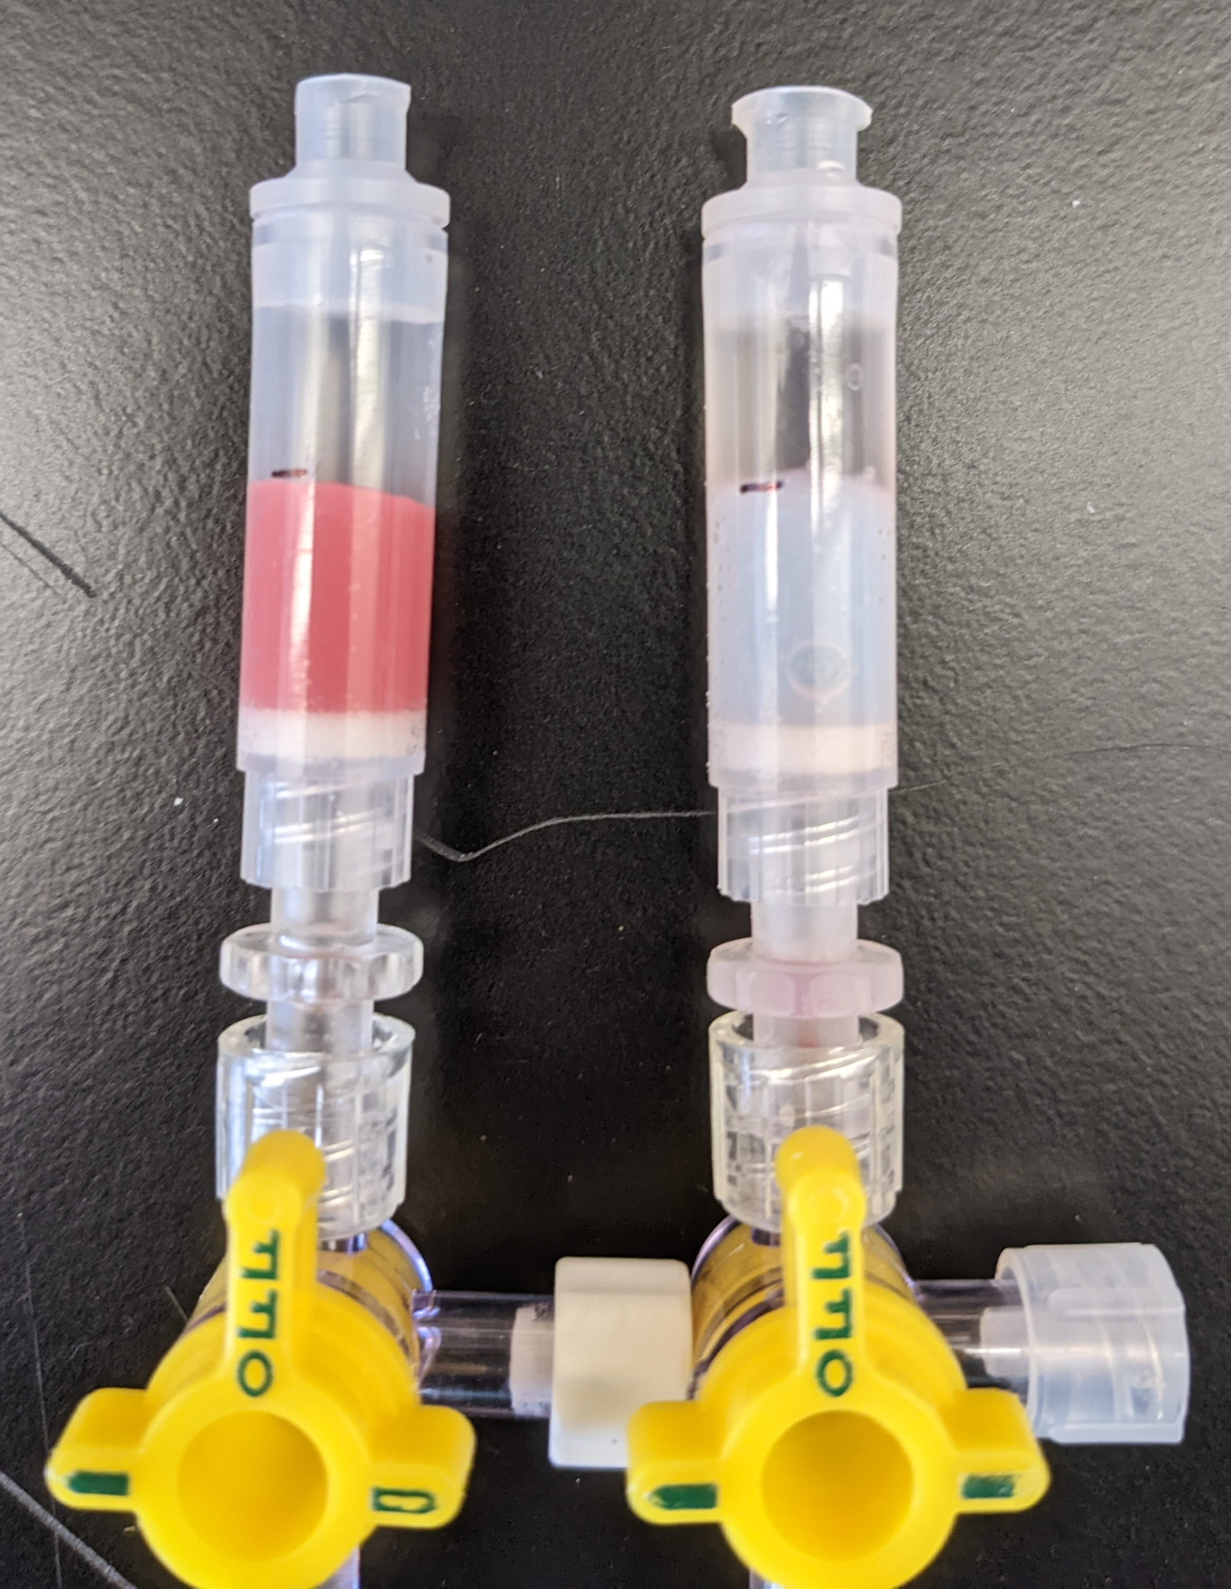
Data
Capture region

Slide 4

Kinetics
B = Hemoglobin in plasma – haptoglobin-bound bead group
P = Available haptoglobin on bead surface
C = Hemoglobin in plasma –control group
BP = Adsorbed hemoglobin-haptoglobin complex
0-D “reactor” kinetics:
$$B+P → BP$$
$\frac{d[BP]}{dt}=k_{r}[B][P$]
$$\frac{d[P]}{dt}=\frac{d[B]}{dt}=−k_{r}[B][P\text{]}$$
$$\frac{d[C]}{dt}=0$$

Slide 5
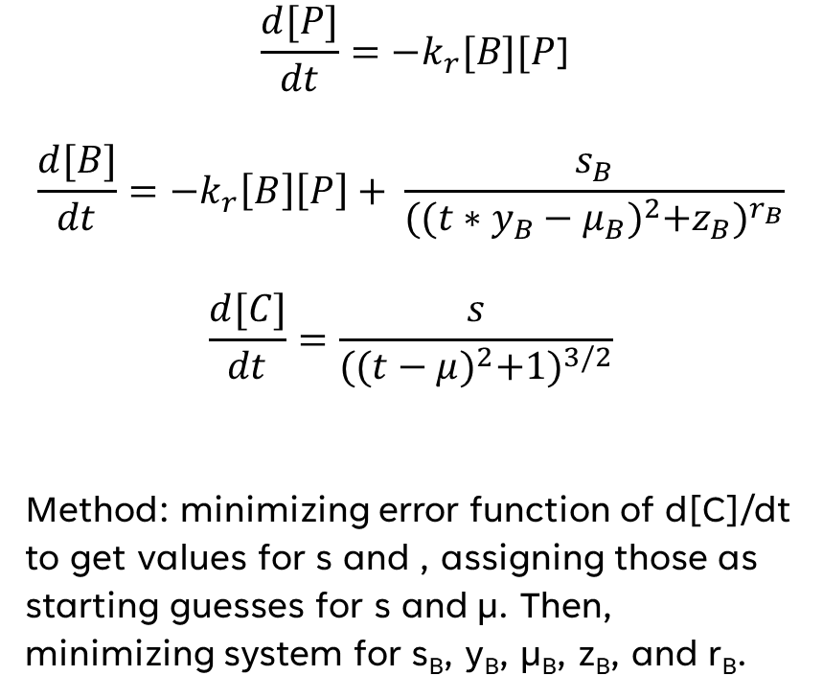
Primary model
Var. | Type | Significance | Value & units
t | IV | Time | 1-24 min
P | DV | Available bound haptoglobin
B | DV | Plasma hemoglobin in study group (SG)
C | DV | Plasma hemoglobin in control group (CG)
k_{r} | OP | Reaction rate constant
s_{B} | OP | Saturation value in SG
y_{B} | OP | Time scale in SG
µ_{B} | OP | Time shift in SG
z_{B} | OP | Model adjustment in SG
r_{B} | OP | Model adjustment in SG
s | OP | Saturation value in CG
µ | OP | Time shift in CG
$$\frac{d[P]}{dt}=−k_{r}[B][P\text{]}$$
$$\frac{d[B]}{dt}=−k_{r}\left[B\right]\left[P\right]+ \frac{s_{B}}{{({(t∗y_{B}−μ_{B})}^{2}+z_{B})}^{r_{B}}}$$
$$\frac{d[C]}{dt}=\frac{s}{{({(t−μ)}^{2}+1)}^{3/2}}$$
Method: minimizing error function of d[C]/dt to get values for s and , assigning those as starting guesses for s and µ. Then, minimizing system for s_{B}, y_{B}, µ_{B}, z_{B}, and r_{B}.

Slide 6
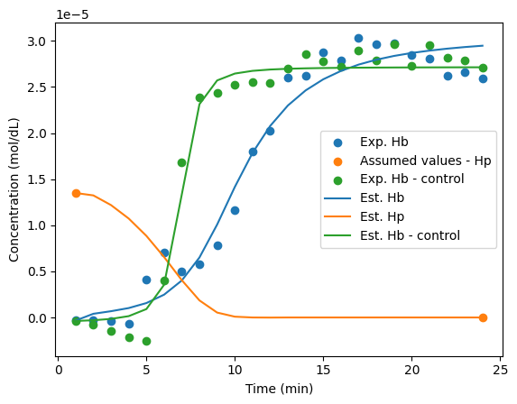
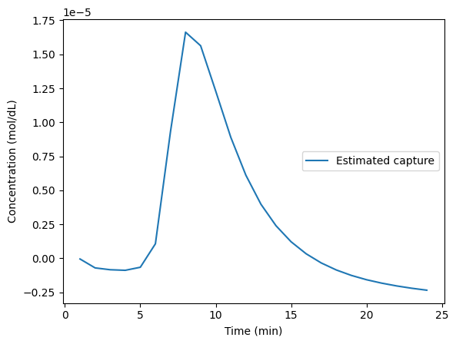
Accuracy of model

Slide 7
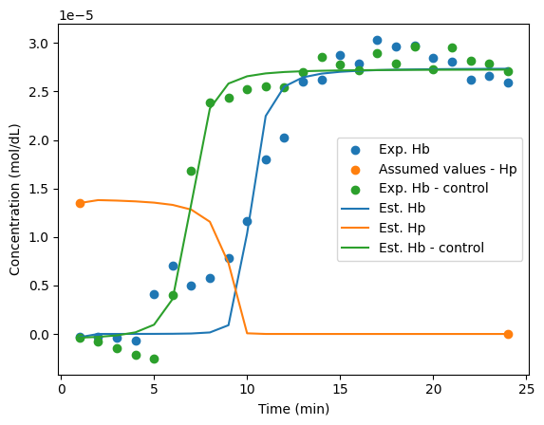
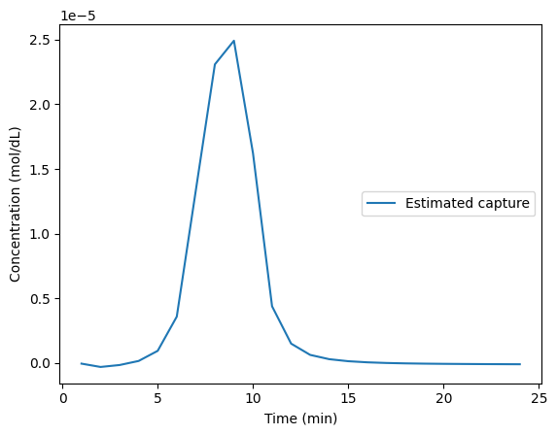
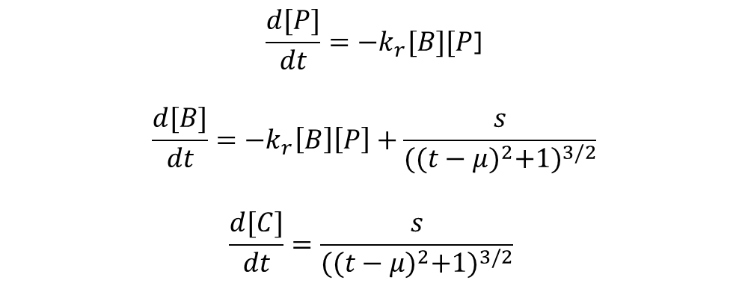
Other attempted model
$$\frac{d[P]}{dt}=−k_{r}[B][P\text{]}$$
$$\frac{d[B]}{dt}=−k_{r}\left[B\right]\left[P\right]+\frac{s}{{({(t−μ)}^{2}+1)}^{3/2}}$$
$$\frac{d[C]}{dt}=\frac{s}{{({(t−μ)}^{2}+1)}^{3/2}}$$

Slide 8
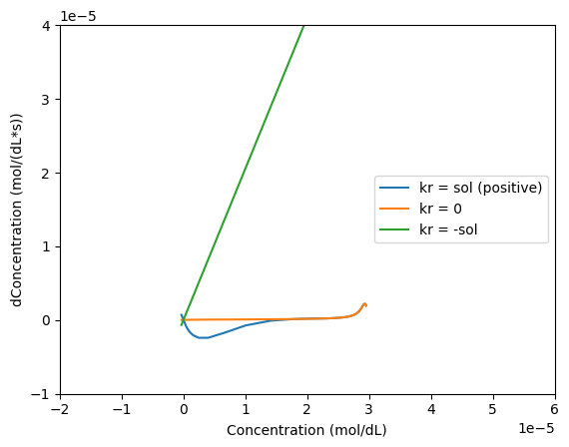
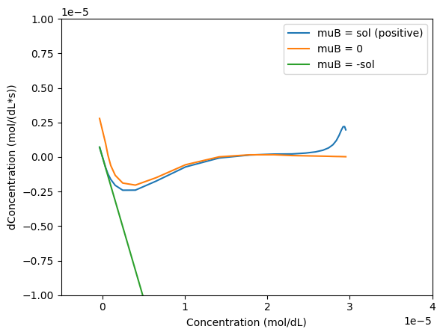
Bifurcation analysis
Stable
Unstable

Slide 9
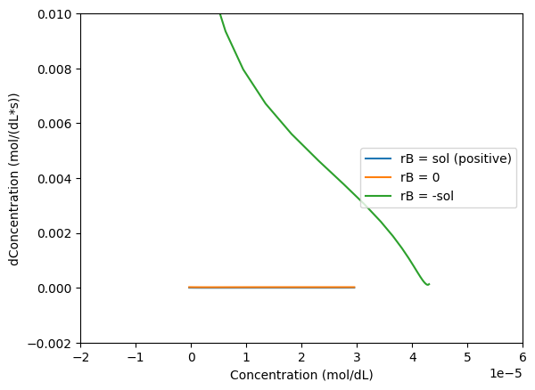
Stable
Unstable
Bifurcation analysis Continued
Solutions follow extremely different paths over the test time range when parameters are bifurcated
Steadystates are most often found by 0 concentration – reaction is extremely stable when nothing happens

Slide 10
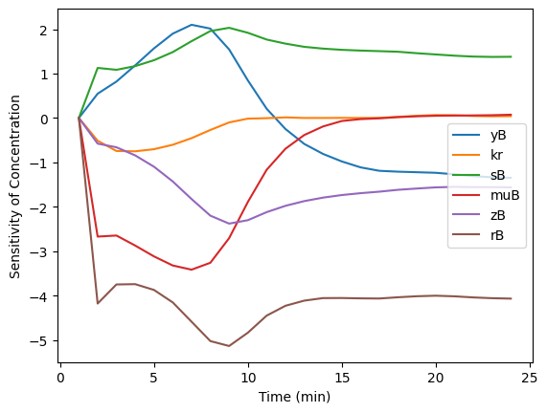
Parametric sensitivity

Slide 11
Limitations & next steps
Model needs refinement – close but not quite
Incorporate original unmodified data to include hemolysis term in analysis
Investigate importance of kr and previous analyses
Attempt analytical solution of concentration via transport & use better sigmoidal solution

Slide 12
THANK YOU
Work made possible by:
Dr. William Federspiel
Dr. Nahmah Kim-Campbell
Anna Maywar

